Slide 1
Lecture-7
History of Bengal
(Medieval /Muslim period)

Slide 2
Economy
Economy
The Indian economy was large and prosperous under the Mughal Empire. During the Mughal era, the gross domestic product (GDP) of India in 1600 was estimated at about 22.4% of the world economy, the second largest in the world, behind only Ming China but larger than Europe. By 1700, the GDP of Mughal India had risen to 24.4% of the world economy, the largest in the world, larger than both Qing China and Western Europe. Mughal India was the world leader in manufacturing, producing about 25% of the world's industrial output up until the 18th century. India's GDP growth increased under the Mughal Empire. The Mughals were responsible for building an extensive road system. The empire had an extensive road network, which was vital to the economic infrastructure, built by a public works department set up by the Mughals which designed, constructed and maintained roads linking towns and cities across the empire, making trade easier to conduct.

Slide 3
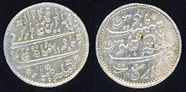
A silver rupee coin made during the reign of the Mughal Emperor Alamgir II

Slide 4
Economy
Agriculture
Indian agricultural production increased under the Mughal Empire. A variety of crops were grown, including food crops such as wheat, rice, and barley, and non-food cash crops such as cotton, indigo and opium. By the mid-17th century, Indian cultivators begun to extensively grow two new crops like maize and tobacco. In early modern Europe, there was significant demand for products from Mughal India, particularly cotton textiles, as well as goods such as spices, peppers, indigo and silks.

Slide 5
Economy
Textile industry
The largest manufacturing industry in the Mughal Empire was textile manufacturing, particularly cotton textile manufacturing, which included the production of piece goods, calicos, and muslins, available unbleached and in a variety of colours. The cotton textile industry was responsible for a large part of the empire's international trade. India had a 25% share of the global textile trade in the early 18th century. Indian cotton textiles were the most important manufactured goods in world trade in the 18th century, consumed across the world from the America to Japan. By the early 18th century, Mughal Indian textiles were clothing people across the Indian subcontinent, Southeast Asia, Europe, the Americas, Africa, and the Middle East. The most important center of cotton production was the Bengal province, particularly around its capital city of Dhaka.

Slide 6
Economy
Bengal accounted for more than 50% of textiles and around 80% of silks imported by the Dutch from Asia, Bengali silk and cotton textiles were exported in large quantities to Europe, Indonesia, and Japan, and Bengali muslin textiles from Dhaka were sold in Central Asia, where they were known as "daka" textiles. Indian textiles dominated the Indian Ocean trade for centuries, were sold in the Atlantic Ocean trade, and had a 38% share of the West African trade in the early 18th century, while Indian calicos were major force in Europe, and Indian textiles accounted for 20% of total English trade with Southern Europe in the early 18th century.

Slide 7
Economy
Shipbuilding industry
Mughal India had a large shipbuilding industry, which was also largely centered in the Bengal province. In terms of shipbuilding tonnage during the 16th–18th centuries, the annual output of Bengal alone totaled around 2,232,500 tons, larger than the combined output of the Dutch (450,000–550,000 tons), the British (340,000 tons), and North America (23,061 tons).
Indian shipbuilding, particularly in Bengal, was advanced compared to European shipbuilding at the time, with Indians selling ships to European firms. Ship-repairing, for example, was very advanced in Bengal, where European shippers visited to repair vessels
The Mughals maintained a small fleet for carrying pilgrims to Mecca.

Slide 8
Other Aspects of culture
Urbanization
Cities and towns boomed under the Mughal Empire, which had a relatively high degree of urbanization for its time, with 15% of its population living in urban centers. This was higher than the percentage of the urban population in contemporary Europe at the time and higher than that of British India in the 19th century; the level of urbanization in Europe did not reach 15% until the 19th century.
Art and architecture
The Mughals made a major contribution to the Indian subcontinent with development of their unique architecture. Many monuments were built during the Mughal era by the Muslim emperors, especially Shah Jahan, including the Taj Mahal, a UNESCO World Heritage Site known to be one of the finer examples of Mughal architecture. Other World Heritage Sites include Humayun's Tomb, Fatehpur Sikri, the Red Fort, the Agra Fort, and the Lahore Fort.

Slide 9
Other Aspects of culture
Painting
Mughal paintings are a particular style of South Asian painting, generally confined to miniatures either as book illustrations or as single works to be kept in albums, which emerged from Persian miniature painting, with Indian Hindu, Jain, and Buddhist influences, and developed largely in the court of the Mughal Empire of the 16th to 18th centuries.

Slide 10
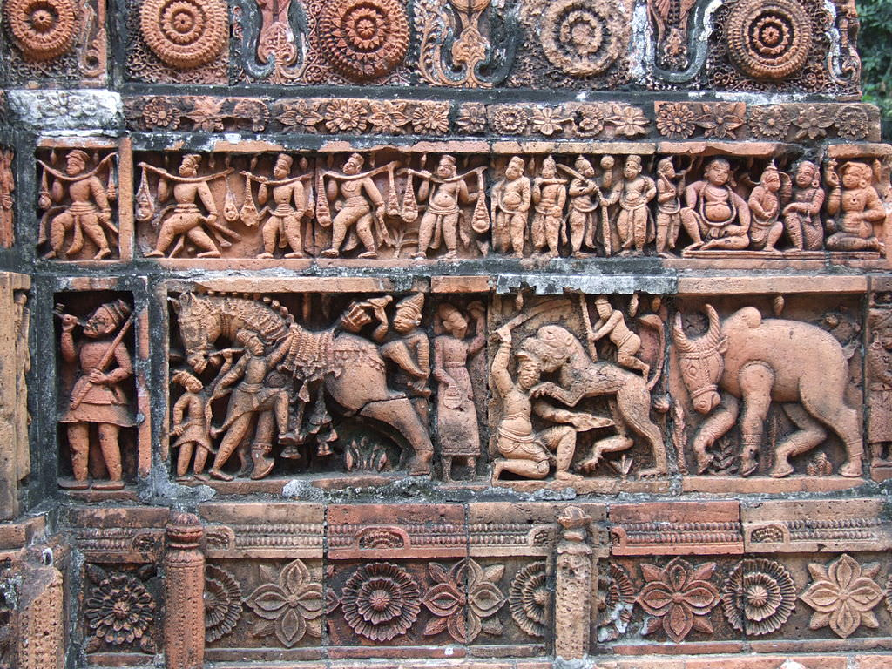
Kantajir Tempel-Terracotta panel

Slide 11
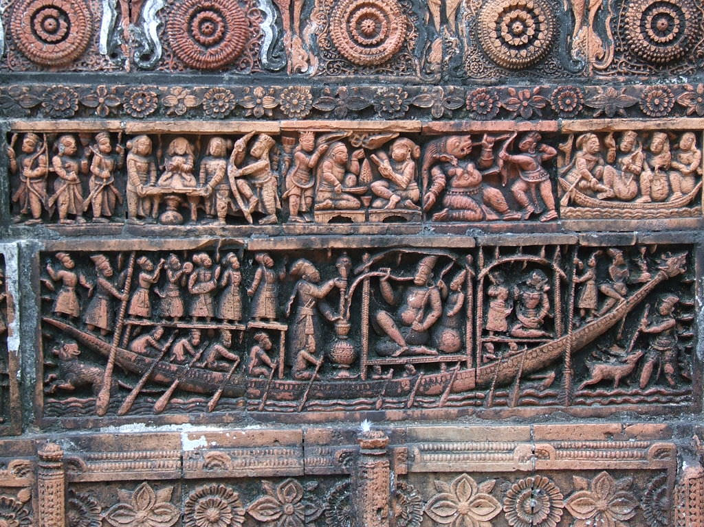
Kantajir Tempel-Terracotta panel

Slide 12
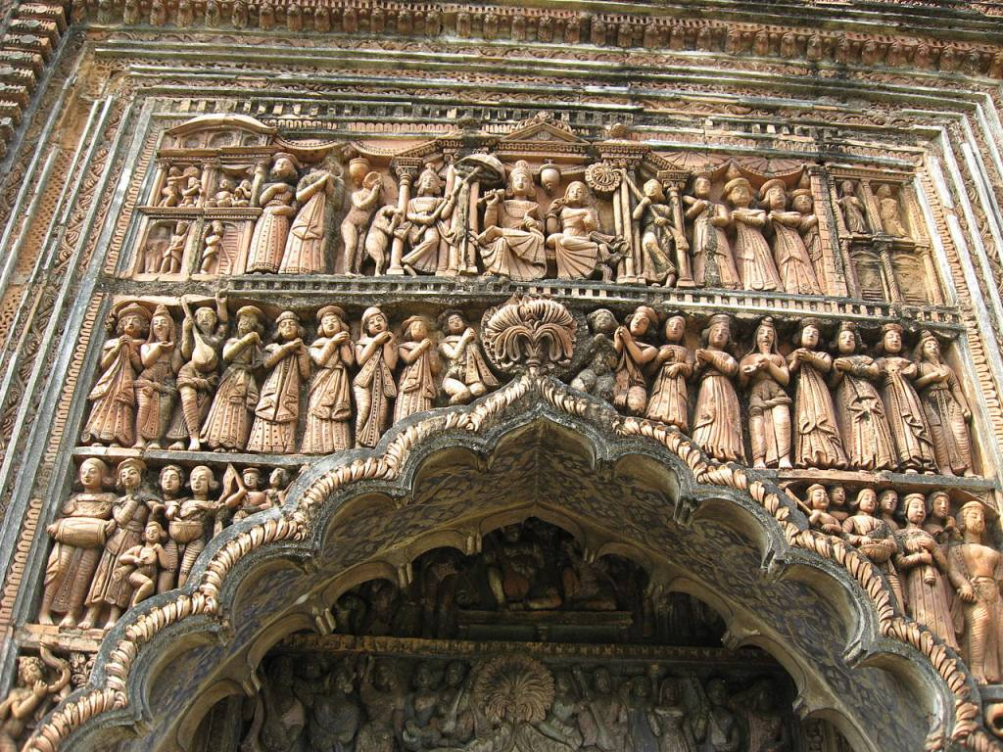
Kantajir Tempel-Terracotta panel

Slide 13
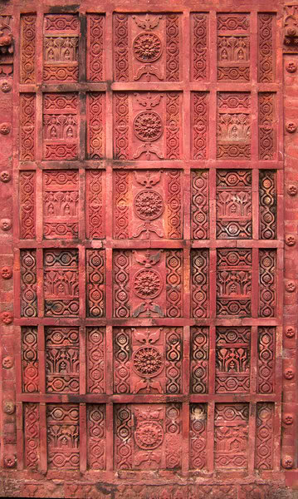
Bengali Islamic terracotta at the 17th-century Atia Mosque in Tangail

Slide 14
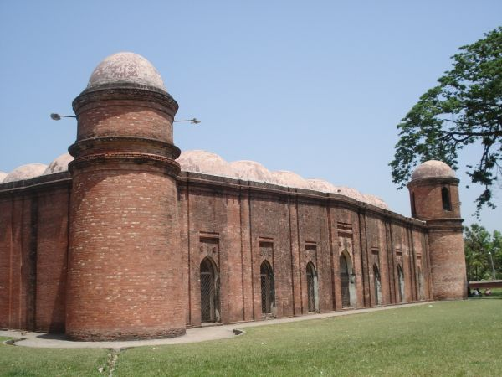
Sixty Dome Mosque in Mosque city of Bagerhat was built in the 15th century and is the largest historical mosque in Bangladesh, as well as a World Heritage site.

Slide 15
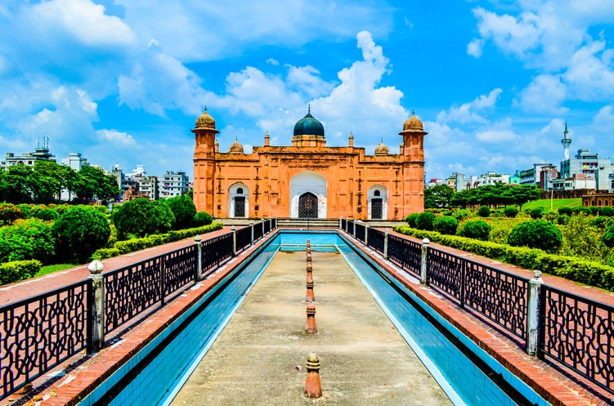
The Lalbagh Fort was developed by Shaista Khan

Slide 16
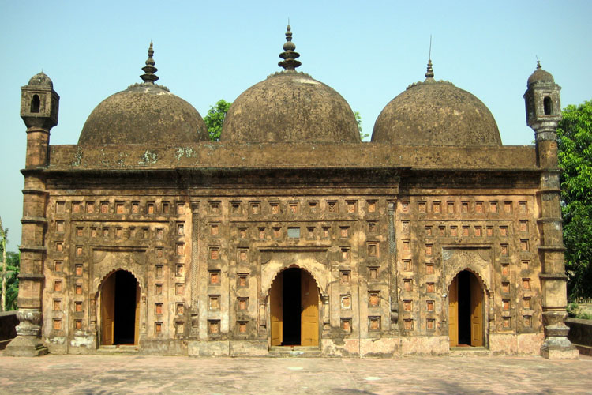

Slide 17
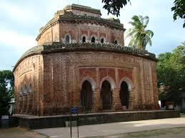

Slide 18
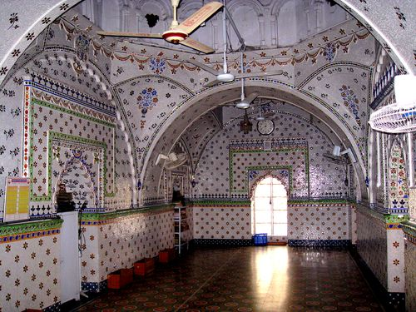

Slide 19
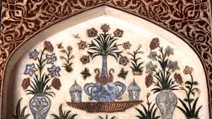

Slide 20
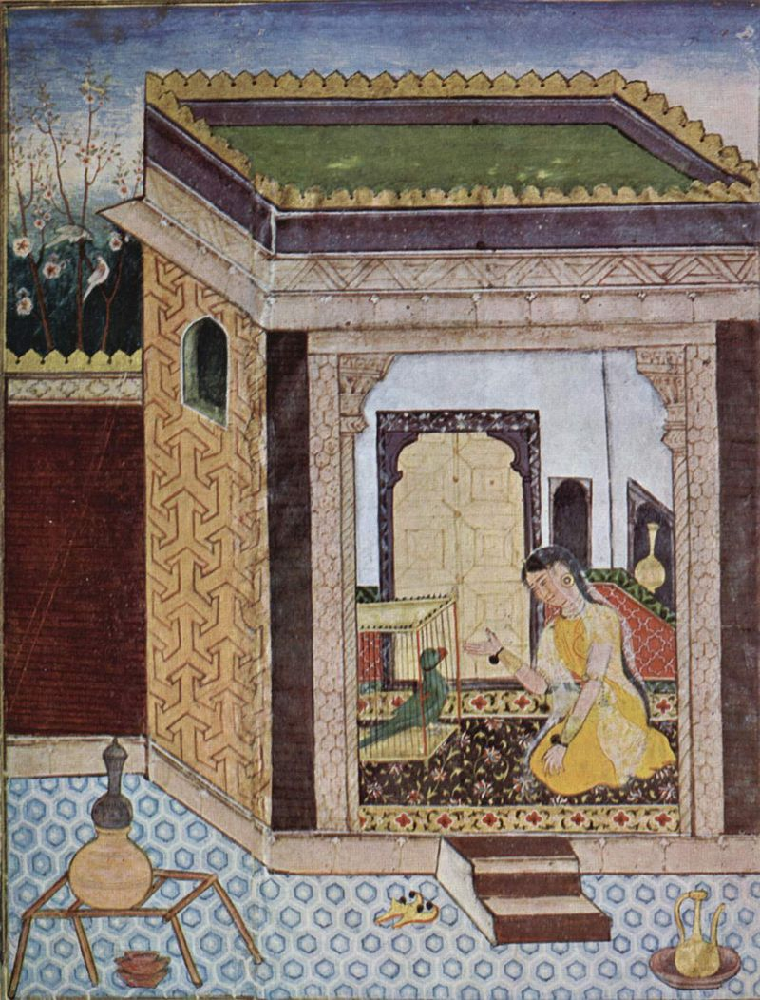
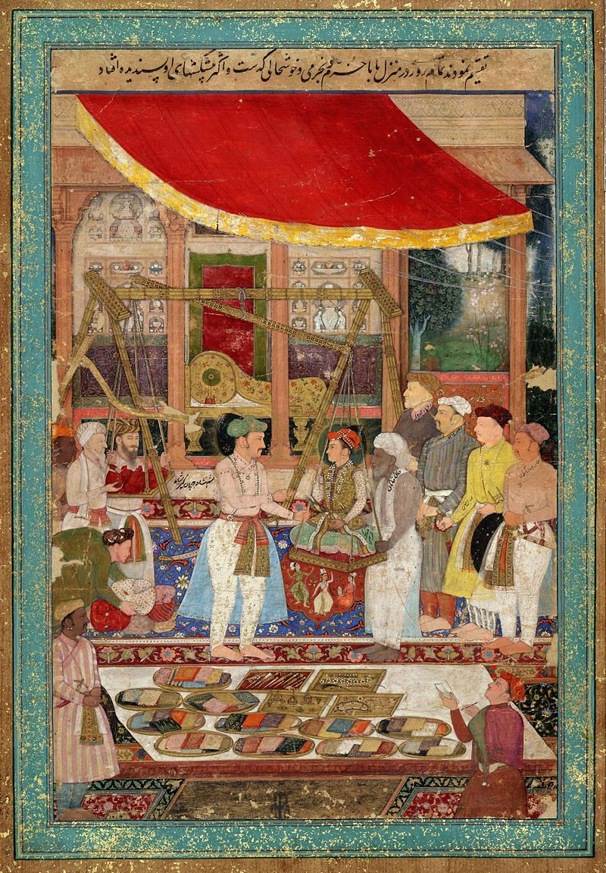

Slide 21
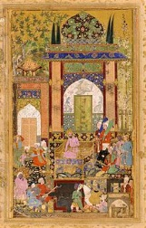
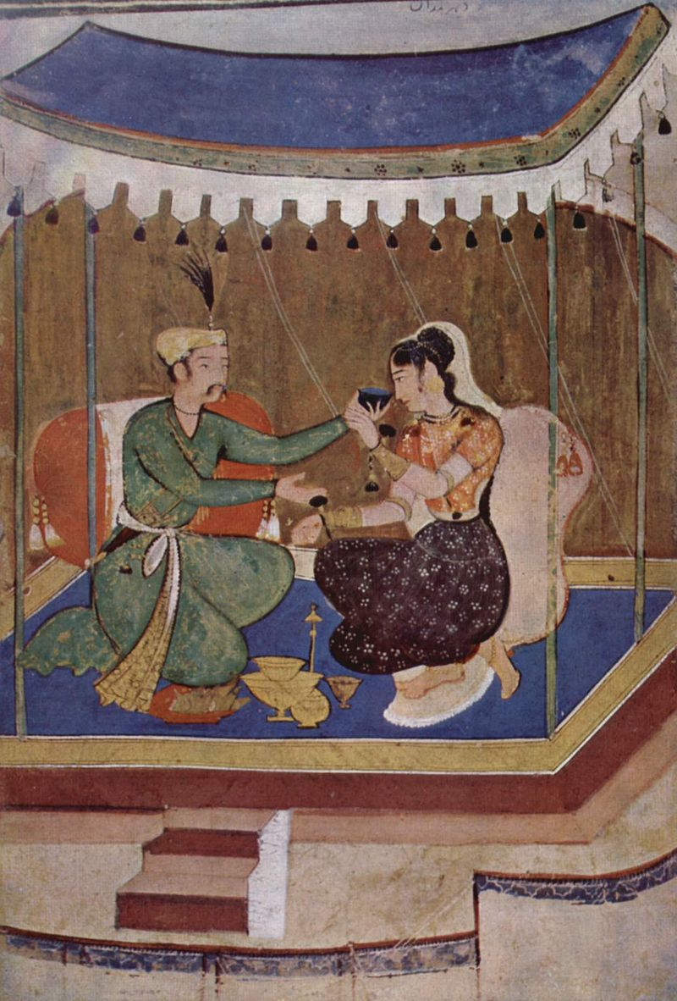

Slide 22
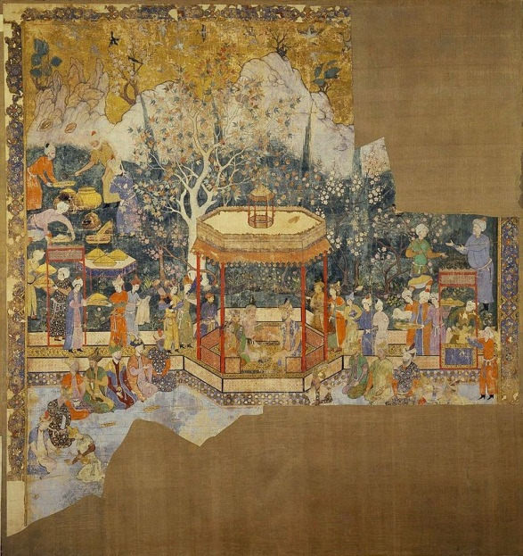
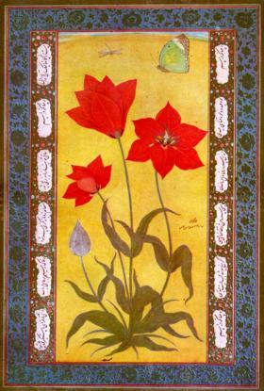

Slide 23
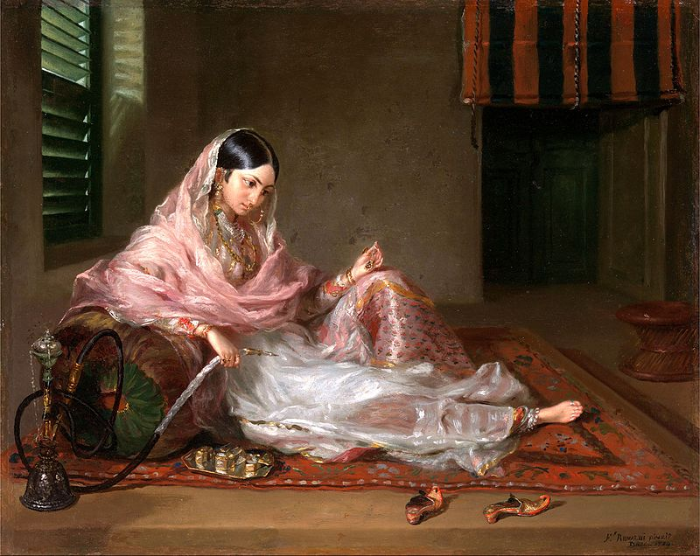
A woman in Dhaka clad in fine Bengali muslin, 18th century

Slide 24
